Slide 1

AI BASED QUIZ SYSTEM
Yash Penkar (22106118)
Prarthana Patil (22106035)
Rutuja Pawar (22106043)
Dhruv Sawant (22106015)
Under the Guidance of
Prof. Shraddha Dalvi

Slide 2
INTRODUCTION
Technology is transforming education and skill development with innovative tools that enhance learning experiences.
Online learning platforms offer flexibility, accessibility, and scalability, enabling self-paced learning for students and professionals.
Traditional paper-based quizzes are inefficient, error-prone, and require manual grading, increasing educators' workload.
Automated quiz systems improve efficiency, accuracy, and provide instant feedback to learners.
Real-time analytics help educators make data-driven decisions to enhance teaching strategies.Secure authentication mechanisms ensure data privacy and user security.
Web-based platforms enable learners to access educational resources anytime, anywhere, making learning more convenient and effective.

Slide 3
Motivation:
The increasing demand for digital learning and assessment tools has highlighted the need for an efficient, intelligent, and automated quiz system.
Traditional e-quiz systems require manual question creation, limiting scalability and adaptability.
Additionally, many existing platforms lack personalization, real-time feedback, and intelligent question generation.
The integration of AI into e-quiz systems can address these limitations by automating quiz creation.
Objectives:
To develop an AI chatbot capable of generating quiz questions dynamically.
To provide an interface for quiz creation, modification, and deletion by administrators.
To ensure secure login, user progress tracking, and leaderboard functionality.

Slide 4
LITERATURE SURVEY OF THE EXISTING SYSTEM
[1] “AI-BASED QUIZ SYSTEM FOR PERSONALISED LEARNING”, Xia Wang, Silke Wrede,Lars van Rijn, Joachim Wöhrle in 16th annual International Conference of Education, Research and Innovation, November 2024.
The AI-Based Quiz System for Personalized Learning uses Python, Neural Networks (NNs), and NLP tools like BERT, RoBERTa, and OCR for quiz generation. A Knowledge Graph Manager (KGM) tracks learning progress, while an LMS plug-in (e.g., Moodle) integrates personalized quizzes. ML models adapt questions based on learners' knowledge levels.
[2] “AUTOMATIC GENERATION OF MULTIPLE CHOICE QUESTIONS FOR E-ASSESSMENT”: A. Santhanavijayan*, S.R. Balasundaram, S. Hari Narayanan, S. Vinod Kumar and V. Vignesh Prasad in International Journal of Signal and Imaging Systems Engineering · January 2017.
The Automatic MCQ Generation System uses Python with Natural Language Processing (NLP) techniques like POS tagging, ontology-based analysis, and dependency parsing. It employs fireflies-based preference learning for sentence selection, hypernyms and hyponyms for distractor generation, and Google Search API for extracting relevant content. The system integrates machine learning models to improve MCQ quality and analogy question generation.

Slide 5
[3] “GENERATING AI LITERACY MCQS: A MULTI-AGENT LLM APPROACH”: Jiayi Wang, Ruiwei Xiao, Ying-Jui Tseng, November 2024.
The AI Literacy MCQ Generation System uses LangGraph framework with OpenAI’s GPT-4o-mini for question generation. It employs multi-agent workflows including a Generator Agent, Language Critique Agent, and IWF Critique Agent for refining MCQs. The system aligns questions with Bloom’s Taxonomy and evaluates quality using rule-based and LLM-based validation.
[4] “DESIGN OF ONLINE QUIZ SYSTEM FOR PRACTICE & ASSESSMENT DURING COVID-19”, Kapeel Dev, Rajesh Kumar, Imran saeed, Farooq Iqbal, Khalid Hussain, S. Madeeha Zaidi, M. Waqas Pasha6 in International Journal of Advanced Trends in Computer Science and Engineering, August 2021.
This Online Quiz System is built using PHP, HTML, CSS, JavaScript, JQuery, and AJAX for frontend and interactivity. MySQL is used for database management, while Visual Studio serves as the development environment. The system follows an Iterative Model and supports CRUD operations for quiz management.

Slide 6
[5] “QUIZME: AN AI-POWERED QUIZ GENERATION SYSTEM”, Prof. Abhishek Shivhare, Rohan Kumar Saini, Rishabh, Harshit Mahavar, Mukul Sharma in International Journal of Novel Reasearch and Development , April 2024.
The QuizMe system uses Next.js, Tailwind CSS, and Shards UI for the frontend, while Node.js with Express.js handles the backend. PostgreSQL (managed via Prisma) stores data, and the OpenAI API generates AI-powered quizzes. JWT ensures authentication, and bcrypt secures passwords.
[6] “AUTOMATIC MCQ GENERATION USING MACHINE LEARNING ALGORITHM” : Ganesh Wani, Kulashri Kale, Deep Kale , Shivam Shinde in International Research Journal of Engineering and Technology, June 2024.
The Automatic MCQ Generation System uses Python with Flask for the backend and React.js with Bootstrap for the frontend. NLTK, spaCy, BERT, and RoBERTa handle NLP tasks like text preprocessing, key information extraction, and distractor generation. K-Means Clustering helps in question selection, while PostgreSQL manages data storage.

Slide 7
[7] “MCQGEN: A LARGE LANGUAGE MODEL-DRIVEN MCQ GENERATOR FOR PERSONALIZED LEARNING”: Ching Nam Hang, Pei-duo Yu, Chee Wei Tan in Institute of Electrical and Electronics Engineers, June 2024.
The MCQGen uses GPT-4 with Retrieval-Augmented Generation (RAG) for MCQ generation. It integrates Chain-of-Thought (CoT) and Self-Refine prompting for refining questions. The system leverages an external knowledge base and employs crowdsourcing-based feedback to enhance question quality.
[8] “GENMCQPRO: AI-DRIVEN MCQ REVOLUTION”: Muralidharan A, Prem Raj, Rohan Vignesh S, Neyan AM, Dr. S. Hemamalini in Technix International Journal for Engineering Research, July 2024.
The GenMCQPro System uses T5 Transformer for question generation and sense2vec for semantic similarity analysis in distractor creation. It employs MultipartiteRank for keyword extraction, spaCy & NLTK for tokenization, and PyTorch & Transformers for model execution. The system integrates Levenshtein distance for text similarity and runs in a Python environment with NumPy, pandas, and flashtext.

Slide 8
LIMITATIONS OF THE EXISTING SYSTEM
Some systems do not support adaptive learning features where quiz difficulty adjusts based on user performance.
Some systems do not have secure database management (Passwords are not securely stored).
Some systems do not have role-based authentication (No Admin, Paper Setter, Candidate roles).
Some systems do not have real-time leaderboard or student performance tracking.

Slide 9
PROBLEM STATEMENT
The conventional quiz creation and evaluation process is often labor-intensive, time-consuming, and lacks adaptability to individual learning needs. To address these challenges, we propose the development of an AI-based quiz system that automates quiz generation, grading, and feedback. This system ensures personalized and adaptive assessments, enhancing accuracy, reducing educator workload, and fostering improved student engagement and learning outcomes.

Slide 10
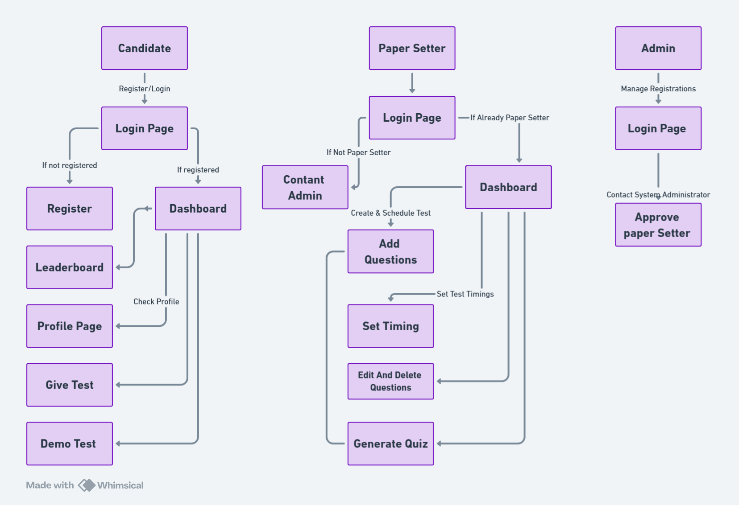
PROPOSED SYSTEM DIAGRAM

Slide 11
EXPLANATION OF DIAGRAM
1. User Authentication and Role-Based Access
A user (candidate, paper setter, or admin) starts by logging in or registering.
The authentication module verifies user credentials and redirects the user based on their role:
Admin Panel (for managing users and approving paper setters).
Paper Setter Portal (for creating and managing tests).
Candidate Dashboard (for taking tests and viewing results).
2. Admin Panel (Role: Administrator)
The admin panel is responsible for:
Approving paper setters.
Managing users.
Handling system configurations.

Slide 12
3. Paper Setter Portal (Role: Paper Setter)
Paper setters can:
Create and edit questions in the MySQL database.
Manage tests (set schedules, review questions, etc.).
4. Candidate Dashboard (Role: Test-Taker)
Candidates are redirected to the Candidate Dashboard after authentication.
From here, they can:
Attempt quizzes (questions retrieved from the MySQL database).
Submit answers for evaluation.View AI-generated questions powered by Google Gemini AI.
Check the leaderboard for rankings.
5. AI-Generated Questions (Google Gemini AI)
The system integrates Google Gemini AI to generate questions dynamically.
These AI-generated questions are stored in the MySQL database and can be used in quizzes.

Slide 13
6. Leaderboard and Performance Tracking
Candidates can view their rankings on the leaderboard.
The Leaderboard aggregates scores and displays rankings based on test performance.
7. MySQL Database (Central Data Storage)
Stores questions, test data, user credentials, and results.
Used by:Paper
Setter Portal (for question management).
Test Management Module (for scheduling and monitoring tests).
Candidate Dashboard (for retrieving questions and submitting answers).

Slide 14
FRAMEWORK
1. Model Choice & Tool Selection
Model Choice:
Google Gemini AI (via google.generativeai) is used for automated quiz question generation.
The model processes topic-based inputs or PDF content and generates MCQ questions in a predefined format.
Tool Selection:
Backend: Flask (Python 3.8)
Database: MySQL
Frontend: HTML5, CSS, Bootstrap V4.1.3, Jinja2 (Flask Templates)
AI Integration: Google Gemini AI
PDF Handling: PyPDF2

Slide 15
2. Setup and Configuration
Setting Up Libraries
Flask: The web framework to handle HTTP requests and responses.
MySQL: Used as the database to store user details, questions, quiz results, etc.
Google Gemini AI: Integrated for automated quiz question generation based on topics or PDF content.
PyPDF2: Helps extract text from PDFs to generate questions dynamically.
Configuring Backend & Database
Flask connects to MySQL using flaskext.mysql, enabling seamless data retrieval and storage.
MySQL tables such as users, questions, tests, and leaderboard are created for structured data storage.

Slide 16
3. Chunking Strategy for Handling Quiz Data Efficiently
Why Use Chunking?
When dealing with long PDFs or lengthy input text, directly passing it to an AI model can cause:
API request limits (Gemini AI has input size constraints).
Processing inefficiency, as large inputs may lead to poor question generation.
How Chunking Works?
Step 1: Extract text from PDFs page by page.
Step 2: Split extracted text into smaller chunks (e.g., every 1000 characters).
Step 3: Each chunk is sent separately to the AI model to generate multiple sets of questions.
Step 4: The results are merged into a final question set and stored in the database.

Slide 17
4. Developing the Backend Application
User Authentication Module: Handles login, registration, and role-based access.
AI Quiz Generator Module: Takes text input, generates questions, and stores them in MySQL.
Quiz Management Module: Allows users to attempt quizzes, submit answers, and track scores.
Leaderboard Module: Updates and ranks candidates based on quiz performance.
Admin & Paper Setter Module: Admins approve paper setters, and paper setters manage quiz content.

Slide 18
TECHNOLOGIES
Python: Core programming language for the backend.
Flask: Micro web framework used for backend development.
Flask-MySQL: Used for integrating Flask with MySQL database.
MySQL: Relational database for storing user data, quiz questions, and results.
Google Gemini AI: AI model for generating MCQ questions based on text or PDF input.
PyPDF2: Library for extracting text from PDFs to process with AI.
HTML, CSS, Bootstrap: Frontend technologies for UI design and responsiveness.
Jinja2: Template engine for rendering dynamic HTML pages in Flask.
Flask Sessions: Manages user sessions and authentication.

Slide 19
METHODOLOGIES
CRUD Operations: Implemented for managing users, questions, and leaderboard.
Authentication & Authorization: Login, session-based authentication, and role-based access control.
MVC Architecture: Separates Model (database), View (frontend), and Controller (Flask logic).
RESTful API Design: Provides structured endpoints for fetching and updating quiz data.
Chunking Strategy: Splits large PDFs into smaller text sections for efficient AI processing.
Data Normalization: Organizes database tables to eliminate redundancy and improve efficiency.
Role-Based Access Control (RBAC): Restricts functionalities based on Admin, Paper Setter, and Candidate roles.
Security Measures: Uses a secret key for session security, parameterized queries to prevent SQL injection
Leaderboard Ranking Algorithm: Dynamically updates and ranks users based on quiz performance.

Slide 20
DETAILS OF DATABASE
AI Based Quiz System’s database consists of 5 primary tables:
Users – Stores user details and roles.
Questions – Contains quiz questions and options.
Tests – Manages different quizzes and subjects.
Leaderboard – Tracks candidate scores and rankings.
Pending_Paper_Setters – Holds requests for paper setter approvals.
User Input Data Includes:
First Name & Last Name – User’s personal identification details.
Email – Unique identifier used for login authentication.

Slide 21
DETAILS OF DATABASE
User Input Data Includes:
3. Password – Encrypted credential for secure access.
4. Gender – Demographic data for user profile.
5. Date of Birth – Used for registration and verification.
6. Username – Unique display name for leaderboard and quiz tracking.
7. Phone Number – Contact information for user management.
8. Role – Defines user type (Admin, Paper Setter, Candidate).
9. Test Selection – Users select a quiz/test to attempt.
10. Quiz Answers – User-submitted responses stored for evaluation.

Slide 22

IMPLEMENTATION

Slide 23

IMPLEMENTATIONS

Slide 24
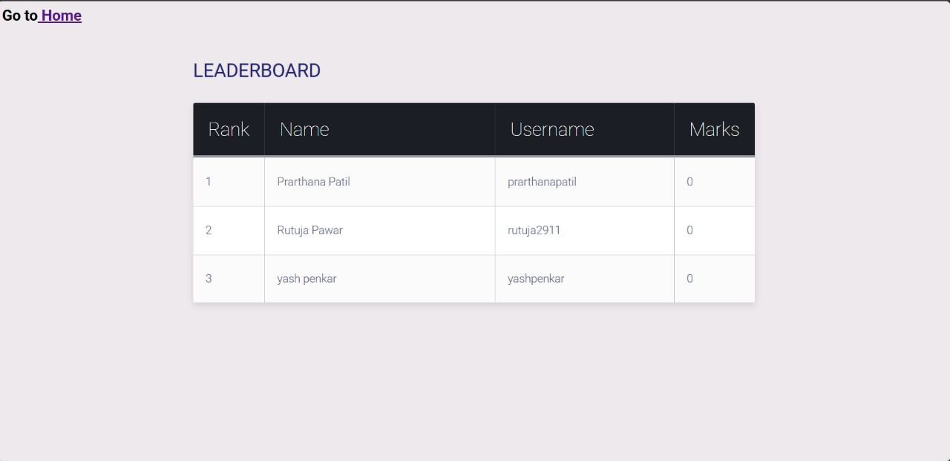
IMPLEMENTATIONS

Slide 25
CONCLUSION
The system streamlines user authentication and session management, ensuring secure and seamless access for users. It efficiently handles quiz creation, editing, and deletion, making it easy for educators and administrators to manage assessments. Real-time scoring and instant feedback enhance the user experience, providing learners with immediate insights into their performance. Additionally, the platform supports dynamic leaderboards, fostering a competitive learning environment that motivates users to improve. Designed to be both secure and scalable, the system is an ideal solution for online assessments and learning, ensuring reliability and efficiency in the digital education landscape.

Slide 26
REFERENCES
[1] “AI-BASED QUIZ SYSTEM FOR PERSONALISED LEARNING”, Xia Wang, Silke Wrede,Lars van Rijn, Joachim Wöhrle in 16th annual International Conference of Education, Research and Innovation, November 2024.
[2] “AUTOMATIC GENERATION OF MULTIPLE CHOICE QUESTIONS FOR E-ASSESSMENT”: A. Santhanavijayan*, S.R. Balasundaram, S. Hari Narayanan, S. Vinod Kumar and V. Vignesh Prasad in International Journal of Signal and Imaging Systems Engineering · January 2017.
[3] “GENERATING AI LITERACY MCQS: A MULTI-AGENT LLM APPROACH”: Jiayi Wang, Ruiwei Xiao, Ying-Jui Tseng, November 2024.
[4] “DESIGN OF ONLINE QUIZ SYSTEM FOR PRACTICE & ASSESSMENT DURING COVID-19”, Kapeel Dev, Rajesh Kumar, Imran saeed, Farooq Iqbal, Khalid Hussain, S. Madeeha Zaidi, M. Waqas Pasha6 in International Journal of Advanced Trends in Computer Science and Engineering, August 2021.
[5] “QUIZME: AN AI-POWERED QUIZ GENERATION SYSTEM”, Prof. Abhishek Shivhare, Rohan Kumar Saini, Rishabh, Harshit Mahavar, Mukul Sharma in International Journal of Novel Reasearch and Development , April 2024.

Slide 27
REFERENCES
[6] “AUTOMATIC MCQ GENERATION USING MACHINE LEARNING ALGORITHM” : Ganesh Wani, Kulashri Kale, Deep Kale , Shivam Shinde in International Research Journal of Engineering and Technology, June 2024.
[7] “MCQGEN: A LARGE LANGUAGE MODEL-DRIVEN MCQ GENERATOR FOR PERSONALIZED LEARNING”: Ching Nam Hang, Pei-duo Yu, Chee Wei Tan in Institute of Electrical and Electronics Engineers, June 2024.
[8] “GENMCQPRO: AI-DRIVEN MCQ REVOLUTION”: Muralidharan A, Prem Raj, Rohan Vignesh S, Neyan AM, Dr. S. Hemamalini in Technix International Journal for Engineering Research, July 2024.

Slide 28
THANK YOU

